Slide 1
DBSCAN

Slide 2
DBSCAN
Find clusters by looking for dense regions
Clusters are regions that are connected through a dense set of data points
Clusters in DBSCAN can therefore take on any shape

Slide 3
DBSCAN
Core samples, any sample that has more than min_samples within a region of size epsilon around it
Min_samples and epsilon are free parameters we choose

Slide 4
DBSCAN
Core samples, any sample that has more than min_samples within a region of size epsilon around it
Non-core samples, any samples that are close to a core sample, but are themselves not core samples

Slide 5
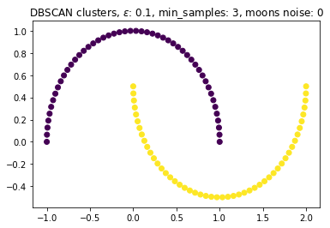
DBSCAN
Clusters are built with a continuous connection of the neighboring core samples. Non-core samples generally lie on the edges of the clusters
Any core sample will be part of a cluster, since core samples define clusters
Any samples that don’t fall into the core or non-core category are outliers

Slide 6
DBSCAN
Find core samples that fulfill epsilon and min samples criterion
Find non-core samples
Connect neighborhoods of core samples
Label clusters and outliers

Slide 7
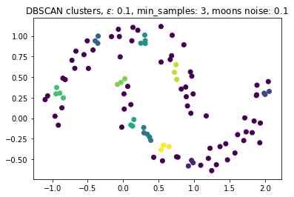
DBSCAN
Find core samples that fulfill epsilon and min samples criterion
Find non-core samples
Connect neighborhoods of core samples
Label clusters and outliers

Slide 8
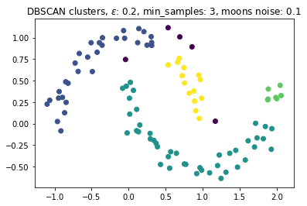
DBSCAN
Find core samples that fulfill epsilon and min samples criterion
Find non-core samples
Connect neighborhoods of core samples
Label clusters and outliers

Slide 9
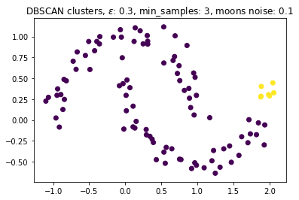
DBSCAN
Find core samples that fulfill epsilon and min samples criterion
Find non-core samples
Connect neighborhoods of core samples
Label clusters and outliers

Slide 10

DBSCAN
Find core samples that fulfill epsilon and min samples criterion
Find non-core samples
Connect neighborhoods of core samples
Label clusters and outliers

Slide 11
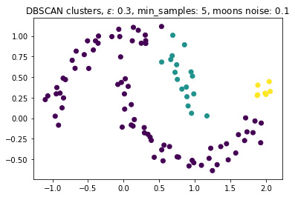
DBSCAN
Find core samples that fulfill epsilon and min samples criterion
Find non-core samples
Connect neighborhoods of core samples
Label clusters and outliers

Slide 12
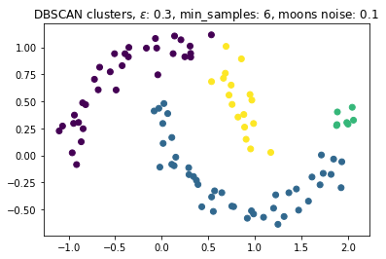
DBSCAN
Find core samples that fulfill epsilon and min samples criterion
Find non-core samples
Connect neighborhoods of core samples
Label clusters and outliers

Slide 13

DBSCAN
Find core samples that fulfill epsilon and min samples criterion
Find non-core samples
Connect neighborhoods of core samples
Label clusters and outliers

Slide 14
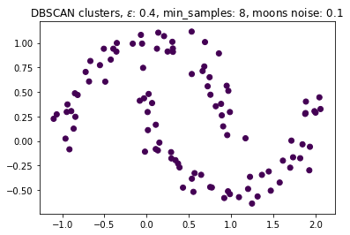
DBSCAN
Find core samples that fulfill epsilon and min samples criterion
Find non-core samples
Connect neighborhoods of core samples
Label clusters and outliers

Slide 15
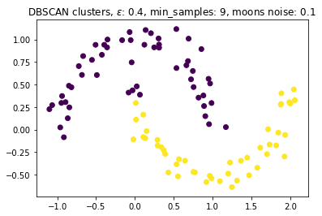
DBSCAN
Find core samples that fulfill epsilon and min samples criterion
Find non-core samples
Connect neighborhoods of core samples
Label clusters and outliers

Slide 16
Considerations
Good when our clusters have comparable densities
A lot of freedom in epsilon and min samples, increase to control for noise, decrease min samples for smaller structures, decrease epsilon for very dense clusters (yet too small means no clusters)
Eps depends on feature scales

